Slide 1

Department of ICT
B.E Sem : II ICT (MU)
Subject Name: MAVC
Unit no:- 4
Unit title:
Vector differential calculus
Subject name : MAVC
Code:
Instructor:
Prof. Foram

Slide 2
Introduction
In this chapter ,we will study
Gradient of a scalar point functions
Directional derivatives
Divergence and Curl of a vector
Conservative vector fields, Irrotational and Solenoidal function

Slide 3
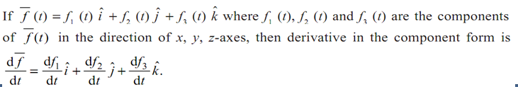
The concept of vector algebra
Vector Function can be decomposed as where are scalar functions of t.
This relation can also be denoted by

Slide 4








The concept of vector algebra
Let be the given curve then

Slide 5
The concept of vector algebra
Example:

Slide 6

The concept of vector algebra
Example: Find unit tangent, unit normal and unit binormal vectors for the curve

Slide 7



GRADIENT
Scalar Point Function
A function f (x, y, z) is called scalar point function defined in the region R, if it associates a scalar quantity with every point in the region R of space.
The temperature distribution in a heated body, density of a body and potential due to gravity are the examples of a scalar point function.
Vector Point Function
A function F (x, y, z) is called vector point function defined in the region R, if it associates a vector quantity with every point in the region R of space.
The velocity of a moving fluid is the examples of vector point function.
Vector Differential Operator Del (∇ )
The vector differential operator Del (or nabla) is denoted by∇ and is defined as

Slide 8
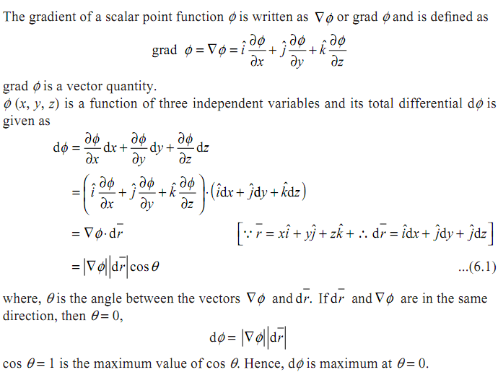
GRADIENT
GRADIENT

Slide 9
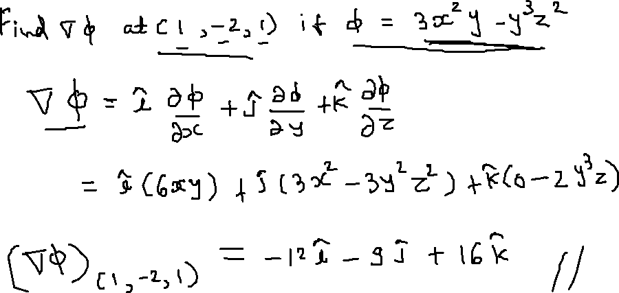
GRADIENT
Example:

Slide 10

GRADIENT
Example:

Slide 11

GRADIENT
Example:

Slide 12
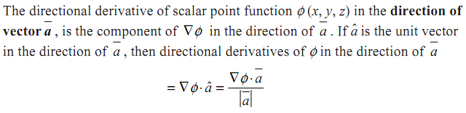
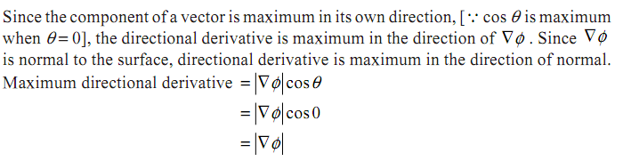
Directional Derivative
Maximum Directional Derivative

Slide 13
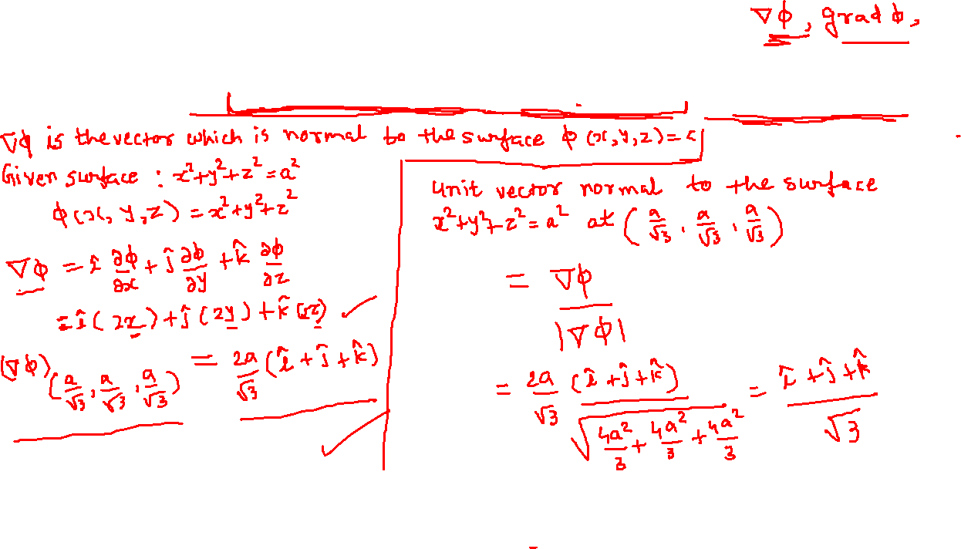
Directional Derivative
Example:

Slide 14
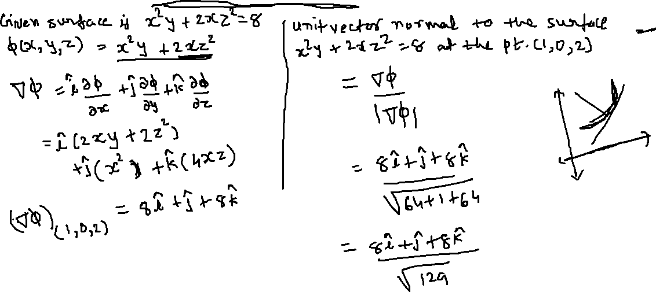

Directional Derivative
Example: Find unit vector normal to the surface x²y + 2xz² = 8 at the point (1, 0, 2).

Slide 15
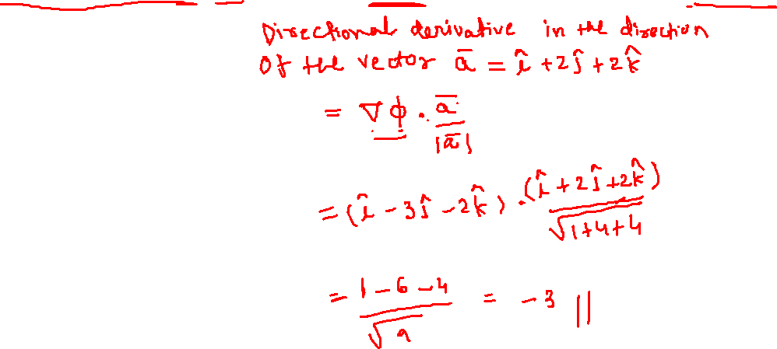
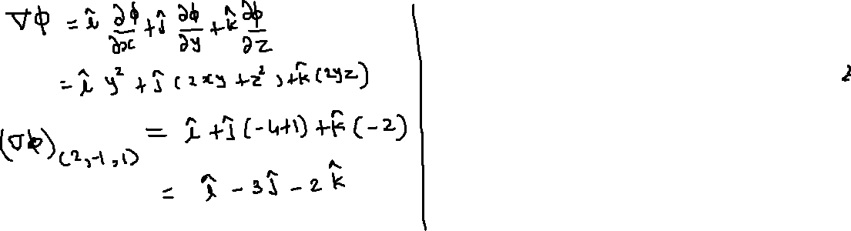
Directional Derivative
Example:

Slide 16
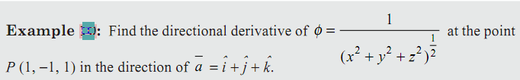
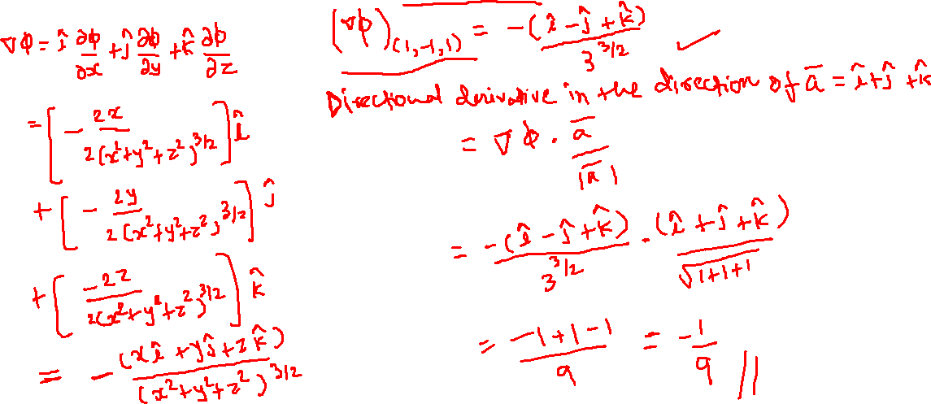
Directional Derivative

Slide 17
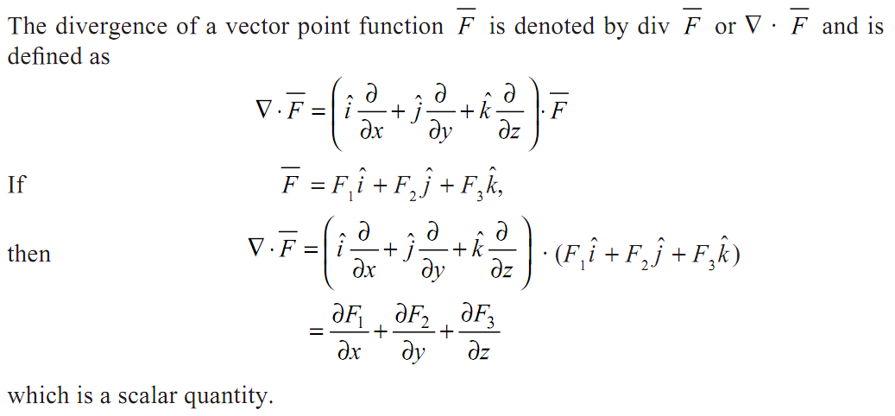
DIVERGENCE and CURL
DIVERGENCE
Solenoidal Function

Slide 18
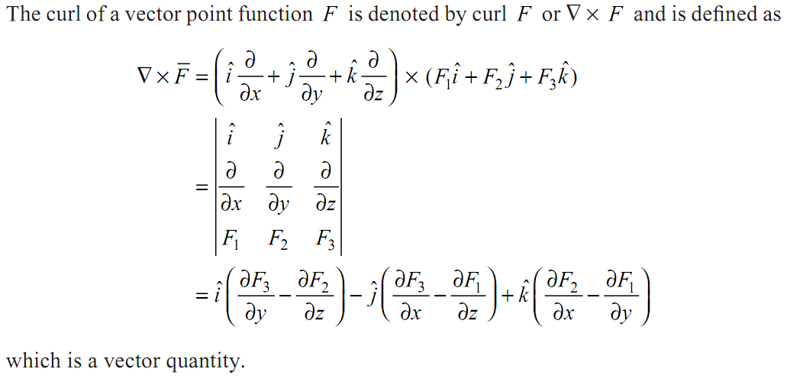
DIVERGENCE and CURL
CURL

Slide 19
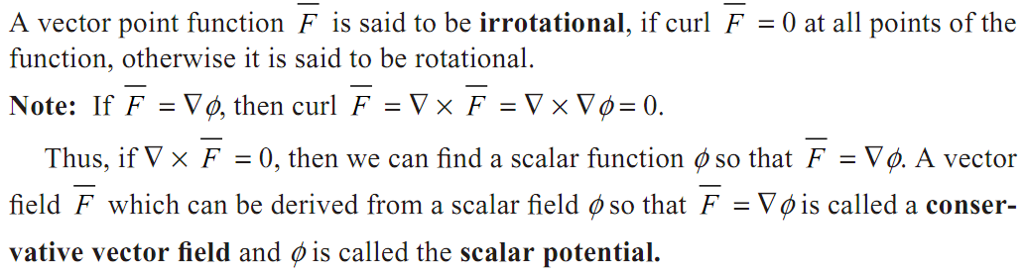
DIVERGENCE and CURL
Irrotational Field

Slide 21
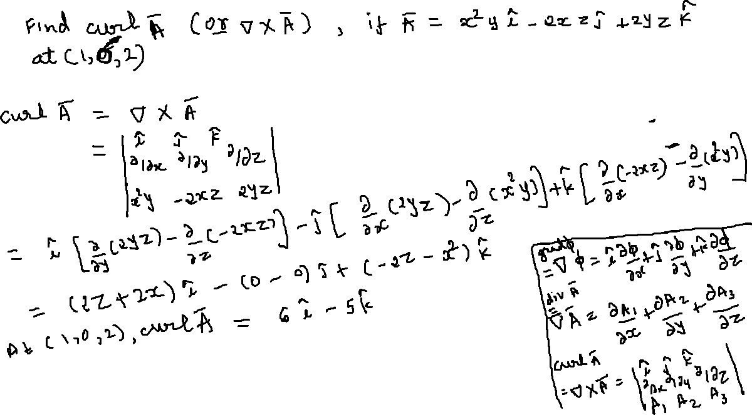

Slide 22



DIVERGENCE and CURL

Slide 24
DIVERGENCE and CURL

Slide 25
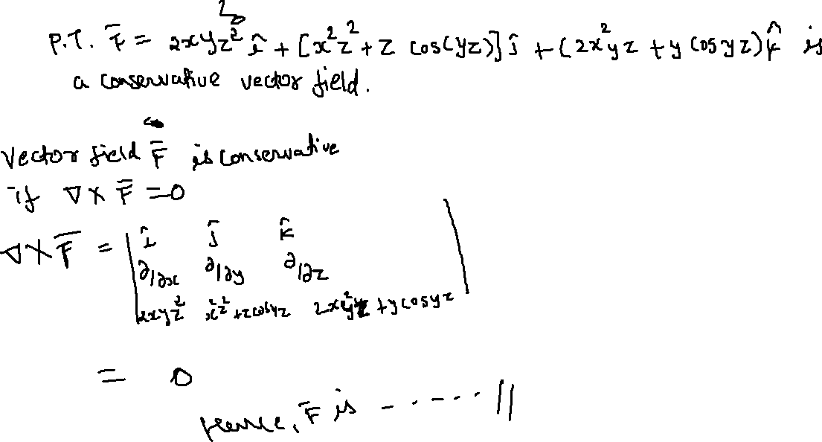

Slide 26
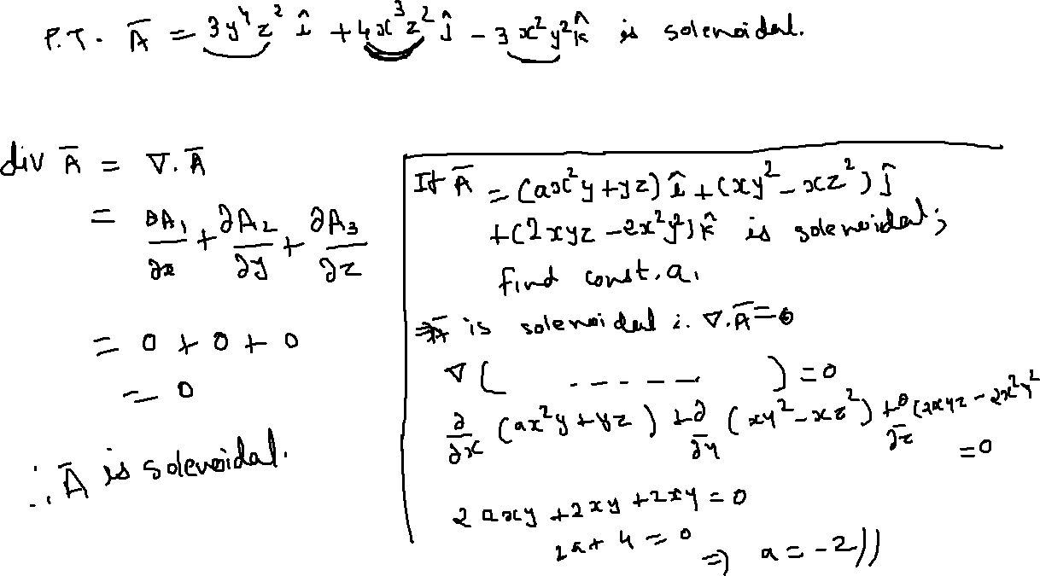

Slide 27
